Slide 1


Green Pace
Security Policy Presentation
Developer: Colin Timberlake

Slide 2

OVERVIEW: DEFENSE IN DEPTH
Our security policy will be to keep our clients safe. We will have security built into our systems. We will have firewalls around our system. Then we will have network security.
Notes:
This security policy is needed because it will cover and help the system. It will start in our app design from our build all the way through our maintenance. This is a blanket to cover our clients and us in all our work. We will cover all aspects of data safety and client safety.

Slide 3
THREATS MATRIX
Likely Insiders | Priority Hackers
Low priority Competitive Intelligence Professionals | Unlikely Information Warriors
Notes:
Insiders- People in your company who fall for scams or an upset employee who wants to cause pain
Hackers- Black Hat Hackers, or people who want to get our information and data and sell it or make us pay to get it back.
Competitive Intelligence Professionals- This is our business competitors. They are trying to get a competitive edge over us and learn what we are doing
Information Warriors- this is people who want to find out information and what we must hide.
We can use automation to then start watching our systems. This will allow for us to monitor our systems without having to have someone working all 24 hours a day. Then we can use it to also do some pen testing.

Slide 4
10 PRINCIPLES
Validate Input Data- INT-050-CPP, STR-050-CPP, DCL-058-CPP
Heed Compiler Warnings- ERR-051-CPP, EXP-053-CPP
Architect and Design for Security Policies- STR-050-CPP, MEM-052-CPP, ERR-050-CPP, OOP-053-CPP, DCL-058-CPP
Keep It Simple- DCL-060-CPP, MEM-051-CPP, ERR-050-CPP, OOP-053-CPP, DCL-058-CPP
Default Deny- INT-050-CPP, STR-050-CPP, ERR-050-CPP
Adhere to the Principle of Least Privilege-
Sanitize Data Sent to Other Systems- EXP-053-CPP
Practice Defense in Depth- STR-050-CPP, MEM-051-CPP, DCL-058-CPP
Use Effective Quality Assurance Techniques- DCL-060-CPP, ERR-050-CPP, OOP-053-CPP
Adopt a Secure Coding Standard- MEM-052-CPP, MEM-051-CPP, OOP-053-CPP, DCL-058-CPP
Notes:
1. INT-050-CPP, STR-050-CPP, DCL-058-CPP
2. ERR-051-CPP, EXP-053-CPP
3. STR-050-CPP, MEM-052-CPP, ERR-050-CPP, OOP-053-CPP, DCL-058-CPP
4. DCL-060-CPP, MEM-051-CPP, ERR-050-CPP, OOP-053-CPP, DCL-058-CPP
5. INT-050-CPP, STR-050-CPP, ERR-050-CPP
6
7. EXP-053-CPP
8. STR-050-CPP, MEM-051-CPP, DCL-058-CPP
9. DCL-060-CPP, ERR-050-CPP, OOP-053-CPP
10. MEM-052-CPP, MEM-051-CPP, OOP-053-CPP, DCL-058-CPP

Slide 5
CODING STANDARDS
DCL-060-CPP-Obey The One definition rule
DCL-058-CPP-Do not modify the standard namespaces
OOP-053-CPP-Write constructor member initializers in the canonical order
ERR-051-CPP-Handle all exceptions
ERR-050-CPP-Do not abruptly terminate the program
MEM-052-CPP-Detect and handle memory allocation errors
EXP-053-CPP-Do not read uninitialized memory
STR-050-CPP-Guarantee that storage for strings has sufficient space for character data and the null terminator
INT-050-CPP-Do not cast to an out-of-range enumeration value
MEM-051-CPP-Properly deallocate dynamically allocated resources

Slide 6
ENCRYPTION POLICIES
In Rest-Encryption in rest is data that is storage. This is for when the data is stored in banks. Our policy shall be to limit access to the data here. The data will be stored in a database and encrypted to keep access limited by role
At Flight- Encryption at flight is security when the data is being transferred between two nodes of a network. Our policy for this will be to encrypt the data as we transfer data across the network. When we do this, we will use a hash style encryption style to allow for our data to be protected and safe.
In Use- Encryption in use is the use of data while it is being used and keeping it protected. We can do this if we allow for one encryption standard across all data. Then when we do this in can remain encrypted and then still be used by different nodes.

Slide 7
TRIPLE-A POLICIES
Authentication- Authentication is the ability by the system to know that the user who is trying to access the system can access the system. This will be applied to our system by setting up a user account for each user and having them set a password.
Authorization- Authorization is what the user can do when given access to the network. It allows users to have limited access by role. This allows data and the security of our system to be secure. This will be secured through making sure that our network is safe and that everyone is given access to only certain parts of the system.
Accounting- Accounting provides means of monitoring and capturing the events done by the user while accessing the network resources. For our policy, we can use it to make sure that our system and data is protected. We will also use it to keep track of information leaks.

Slide 8
Unit Testing
Buffer overflow
Static testing
Input Validation
Runtime analysis tools

Slide 9
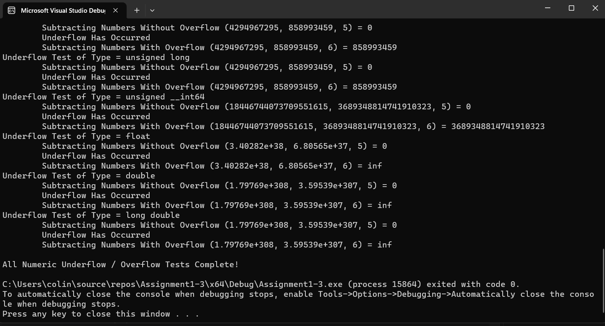
Buffer Overflow

Slide 10
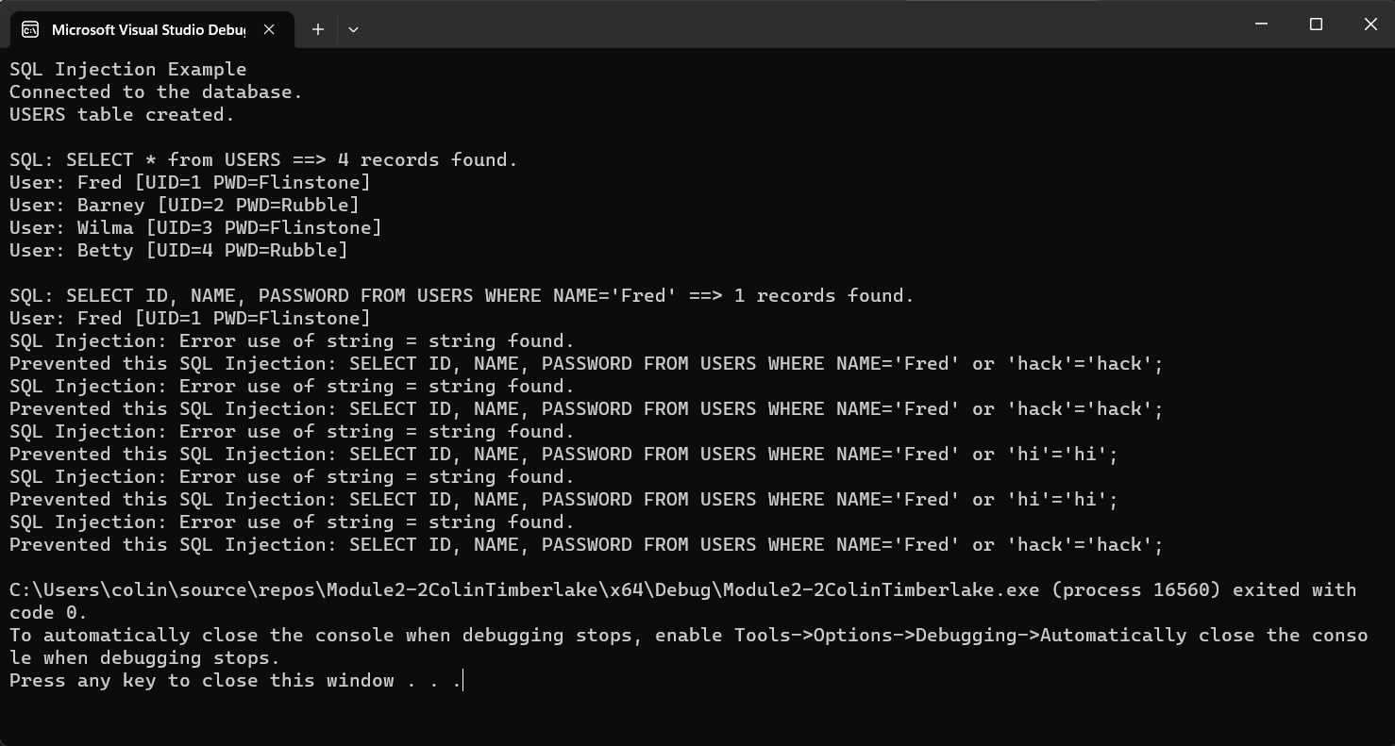
Input Validation

Slide 11
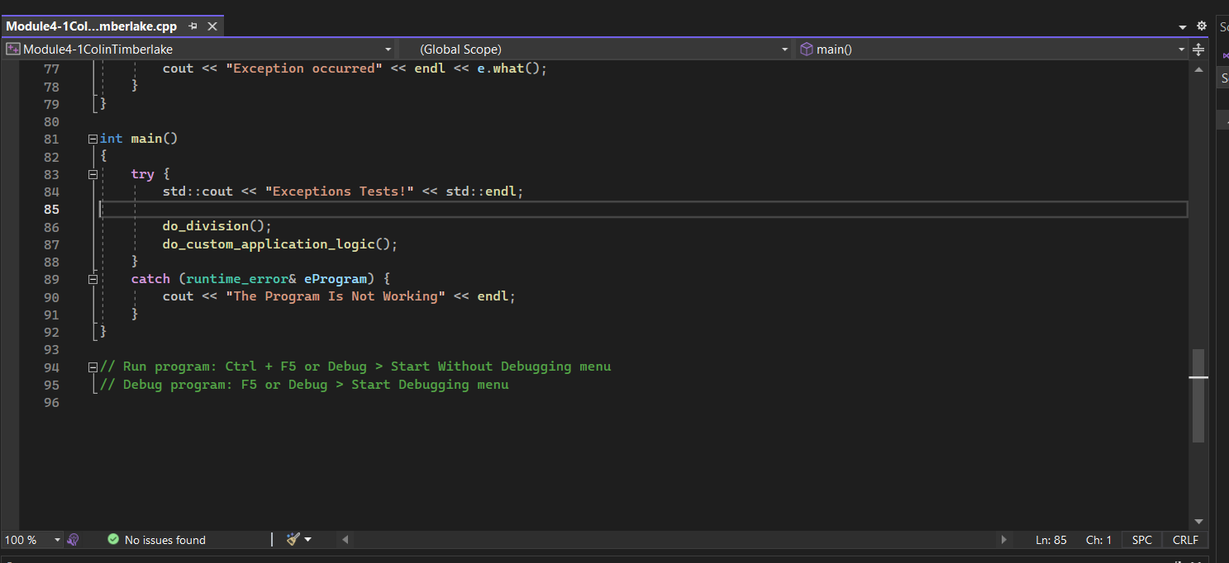
Static testing

Slide 12
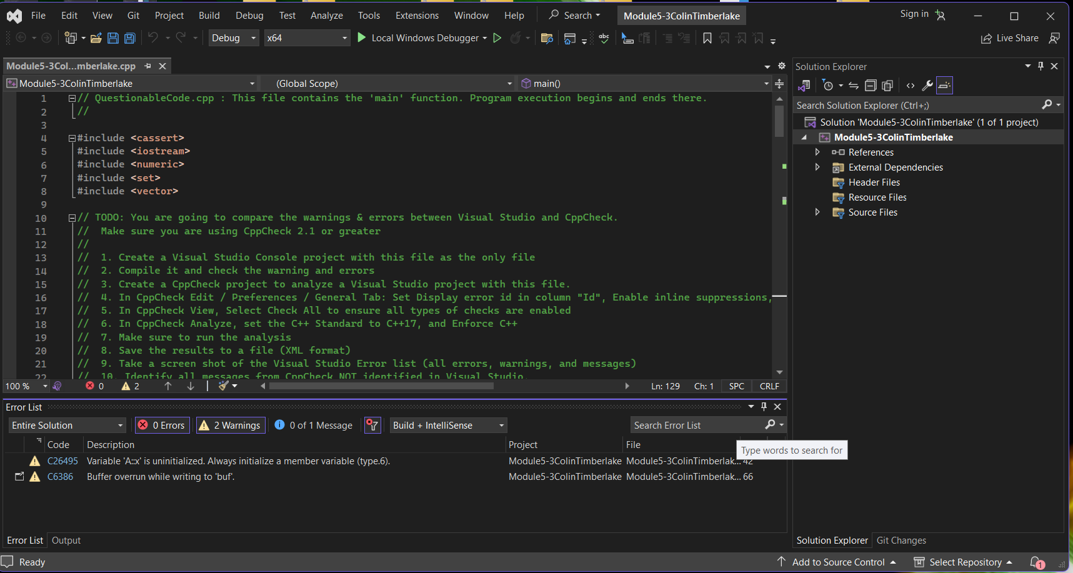
Runtime analysis tools

Slide 13

AUTOMATION SUMMARY
Notes:
Automation will exist in the verify and test step, there will be a compiler in the building step and that will show us errors in the code. The transition and health check will also have automation. We will use some pen tests in both steps. Our monitor and detect stage will also contain some automation. The maintain and stabilize section will also have automation. There will also be some in assess and plan and maintain and stabilize.

Slide 14
TOOLS
DevSecOps Pipeline is the idea that you can implement the CI/CD into the SDLC and includes functions like scanning, threat intelligence, policy enforcement, static analysis and compliance validation.
Automated Testing tools
Application security tools
Log Management tools
Monitoring tools
Alerting tools
Dashboard tools
Threat modeling tools
Notes:
Automated Testing tools- Verify and test, and transition and health check
Application Security Testing tools- monitor and detect, and assess and plan
Log Management tools- Maintain and stabilize
Monitoring tools- monitor and detect, maintain and stabilize
Alerting tools- build, verify and test, transition and health check, monitor and detect, Maintain and stabilize
Dashboard tools-
Threat Modeling tools- Monitor and detect, assess and plan, maintain and stabalize,

Slide 15
RISKS AND BENEFITS
Low Cost now High Cost Later
Loss of Trust, Loss of Customers
Keep your clients and you safe
Nobody expects it to happen, but everyone wishes to have prepared if it does
Notes:
If you are attacked without protection, then there will be high costs to fix the issue, or to get the system back. This will cause you to lose trust with your current clients, and then your reputation will be hurt with future clients, and you could lose future clients.
However, if you act now, we will be there to help you. We will monitor for attacks; we will be able to keep mistakes from getting out of hand. We will make sure that anything that happens will be fixed and we will help your clients feel safer.

Slide 16
RECOMMENDATIONS
Defense in Depth
Too General
Backdoors become inevitable
Automation to human ratio
Notes:
Defense In depth- Some things were not double layered
Too General- too many things trying to be covered
Backdoors- Sense of something being missed
Automation feels like it plays a large role in this and where is it that security with automation becomes a risk versus humans doing it.

Slide 17
CONCLUSIONS
DCL-053-CPP: Do not write syntactically ambiguous declarations
EXP54-CPP. Do not access an object outside of its lifetime
CTR51-CPP. Use valid references, pointers, and iterators to reference elements of a container
Notes:
I feel that these will enhance our security policy. I feel that these would make the most sense and cover some areas that wouldn’t be covered by the ones in the policy but however in their respective groups, it feels like the others would build off these. I feel like these are the basics that would lead into a larger range just like I feel like the others would build into a large range in their perspective arenas.

Slide 18
REFERENCES
singh gill, N. (2023, May 16). A Guide to DevSecOps Tools and Continuous Security For an Enterprise. Www.xenonstack.com. https://www.xenonstack.com/blog/devsecops-tools
The Upwork Team. (2021, June 15). What Is Unit Testing? Frameworks & Best Practices | Upwork. Www.upwork.com. https://www.upwork.com/resources/unit-testing
What is a DevSecOps Pipeline? (n.d.). Check Point Software. Retrieved December 11, 2023, from https://www.checkpoint.com/cyber-hub/cloud-security/devsecops/what-is-a-devsecops-pipeline/#:~:text=A%20DevSecOps%20pipeline%2C%20which%20is

